Slide 1

Cynhadledd Flynyddol 2023
Annual Conference 2023
Llywio cyfleoedd a heriau AI mewn colegau
Navigating the opportunities and challenges of AI in colleges
Llais addysg bellach yng Nghymru | The voice of further education in Wales

Slide 2


Navigating the opportunities and challenges of AI in colleges
Michael Webb

Slide 3
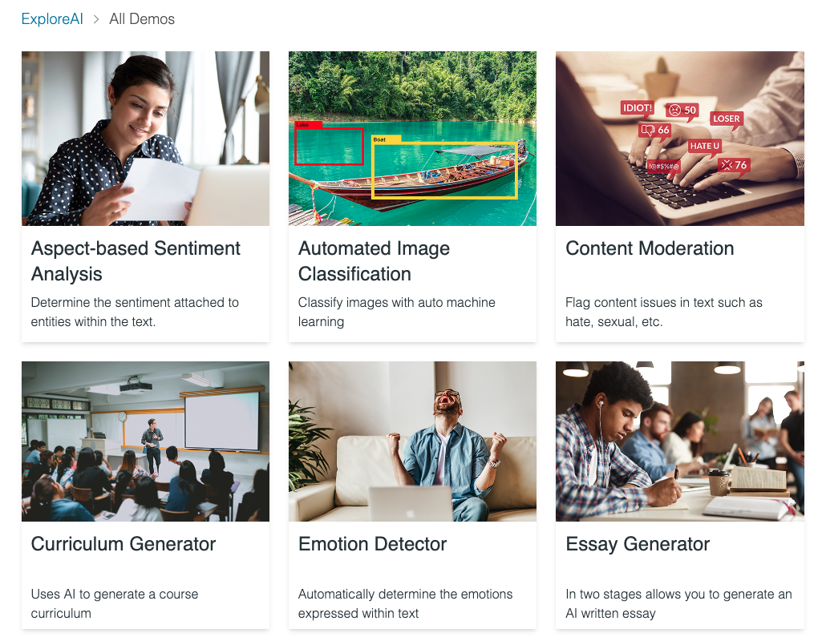




About national centre for AI in tertiary education
Aim: to accelerate the adoption of artificial intelligence across the tertiary education sector in a responsible way.
Pilots
Information
Events
Community

Slide 4
Navigating the opportunities and challenges of AI in education
AI: where are we today?
Challenges: assessment
Challenges: meeting students needs and expectations
Opportunities: saving staff time
Opportunities: new teaching and learning opportunities
Activity: our short, mid and learn term hopes and needs

Slide 5
AI: where are we today?

Slide 6
Things have moved very quickly over the last 12 months…
… and amazingly quickly over the last six months.

Slide 7
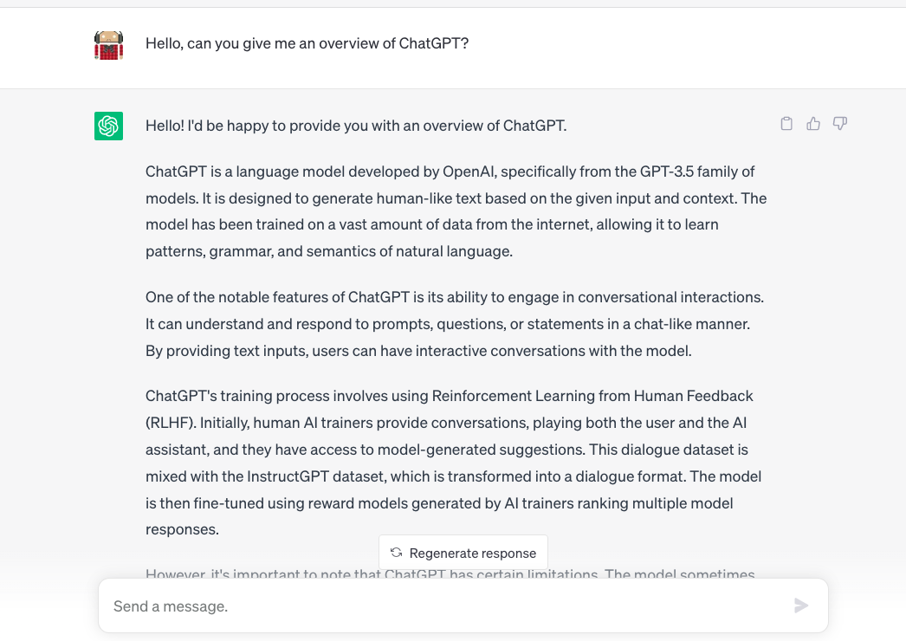
Nov 2022
ChatGPT…

Slide 8















Generative AI is more than ChatGPT…
Chat
Search
Images
Code
Writing
Content
… and many, many more

Slide 9
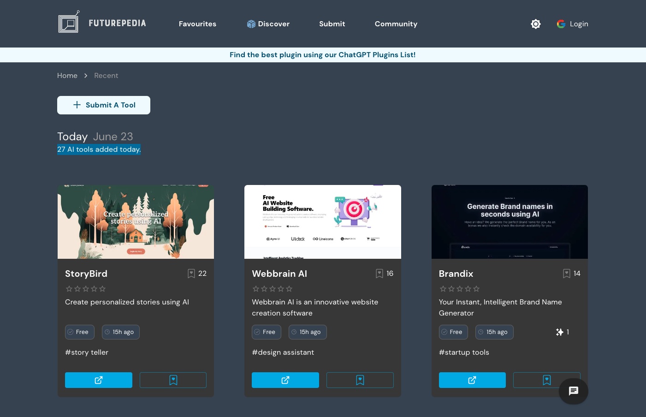
27 new AI applications added in a day to Futurepedia

Slide 10
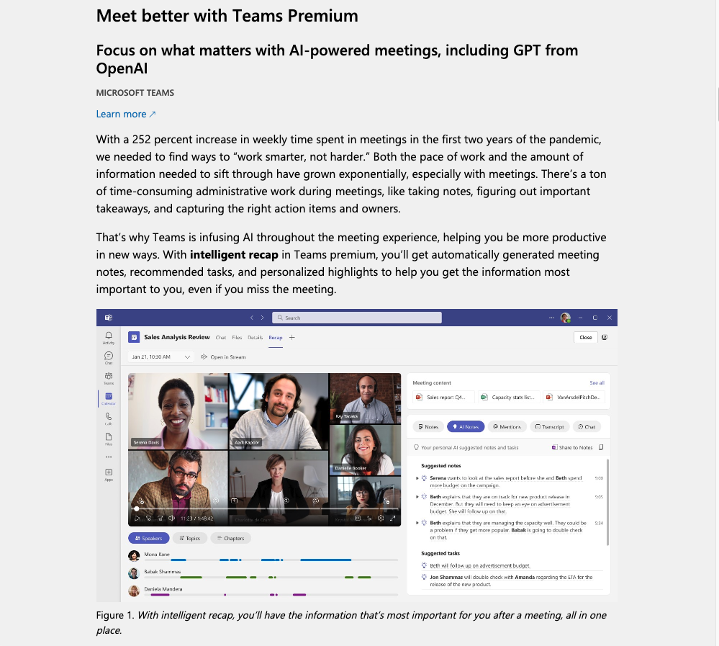
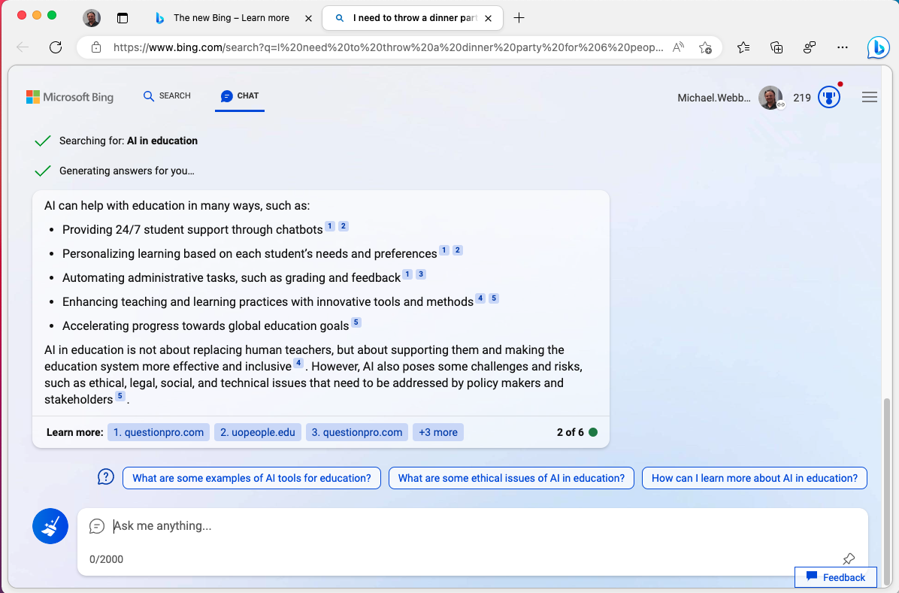
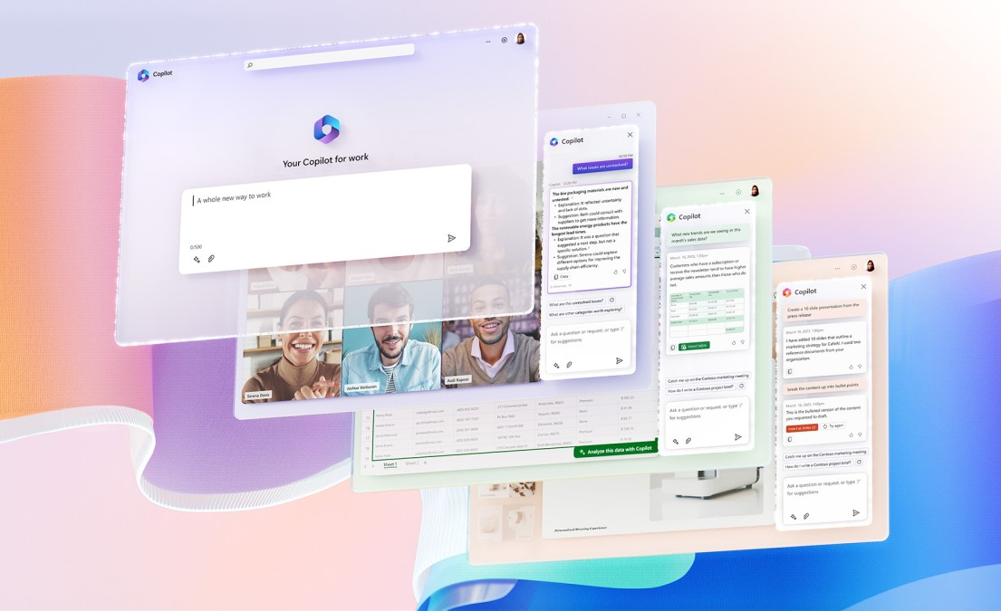
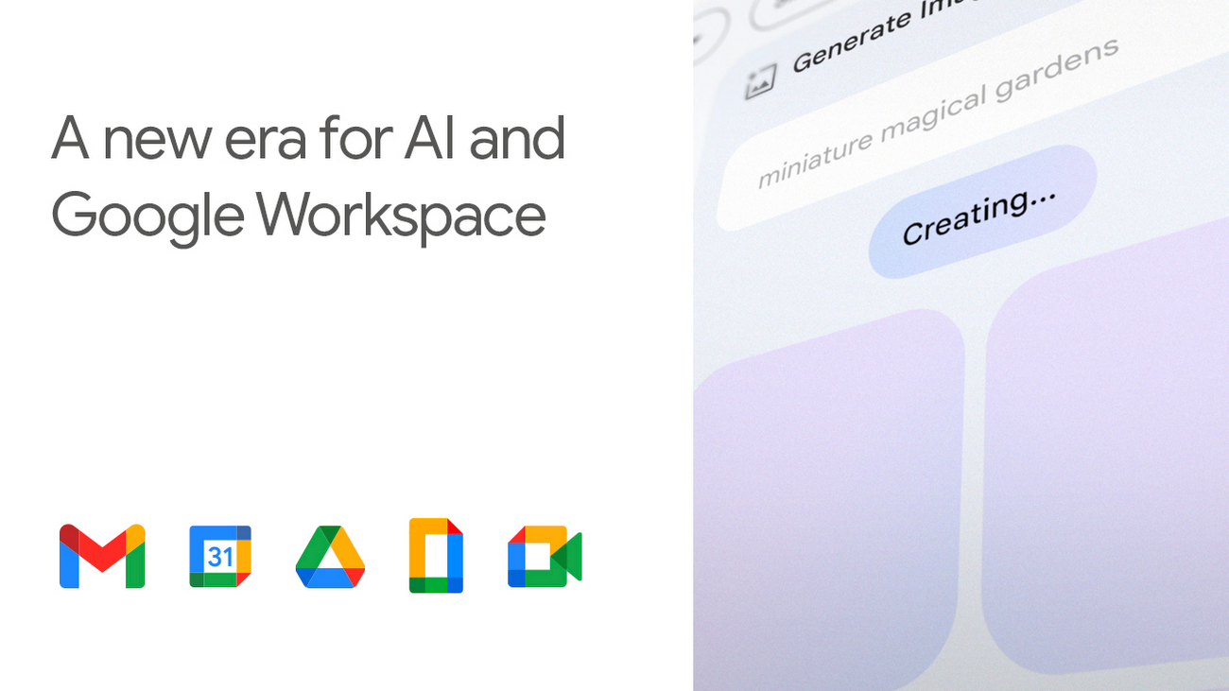
AI and large language models are getting integrated into our everyday tools,
e.g. Microsoft Copilot and Google Workspaces.
10

Slide 11
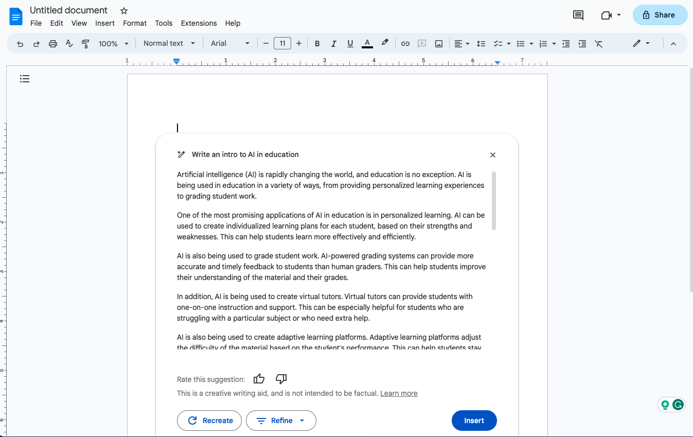
AI in Google Docs, released in June 2023…

Slide 12
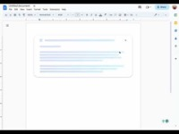
AI in Google Docs, released in June 2023… video

Slide 13
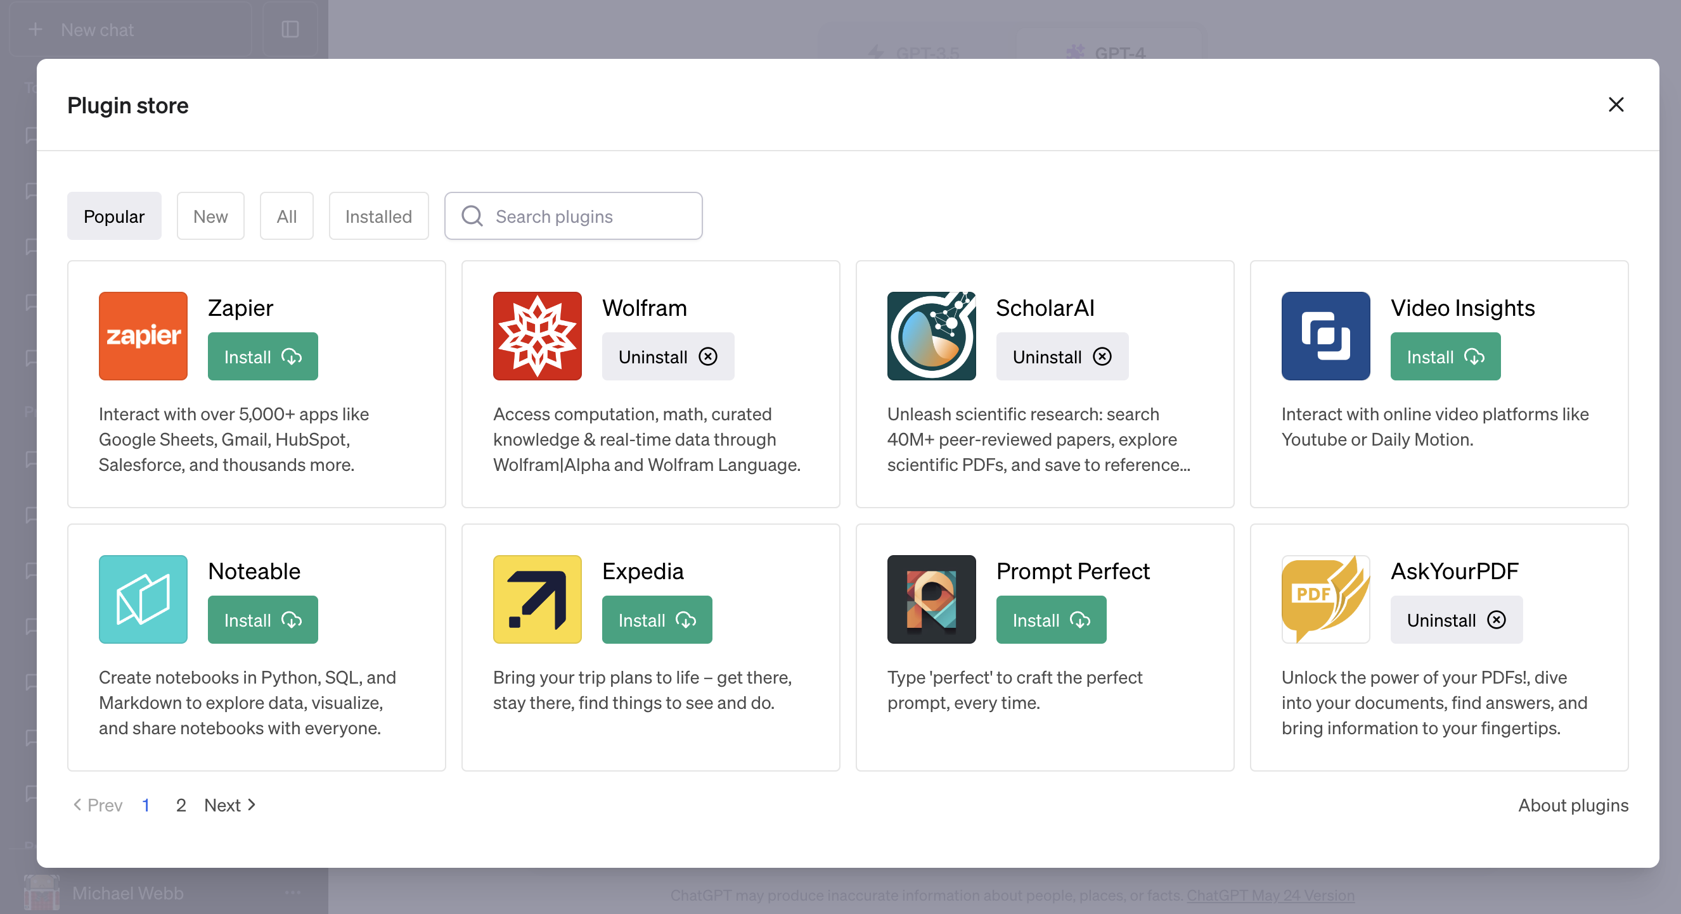
ChatGPT Plus has several hundred plugins…

Slide 14
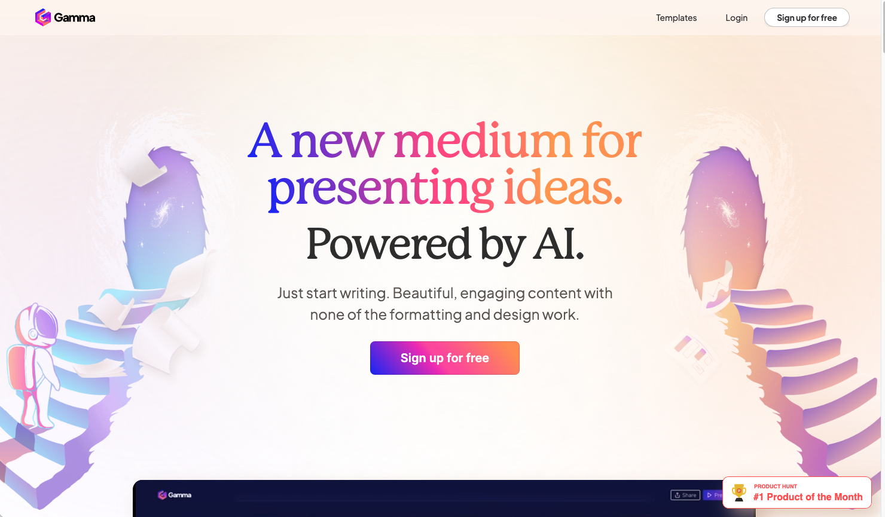
Example of content creation:
https://gamma.app/

Slide 15

Example of content creation video

Slide 16
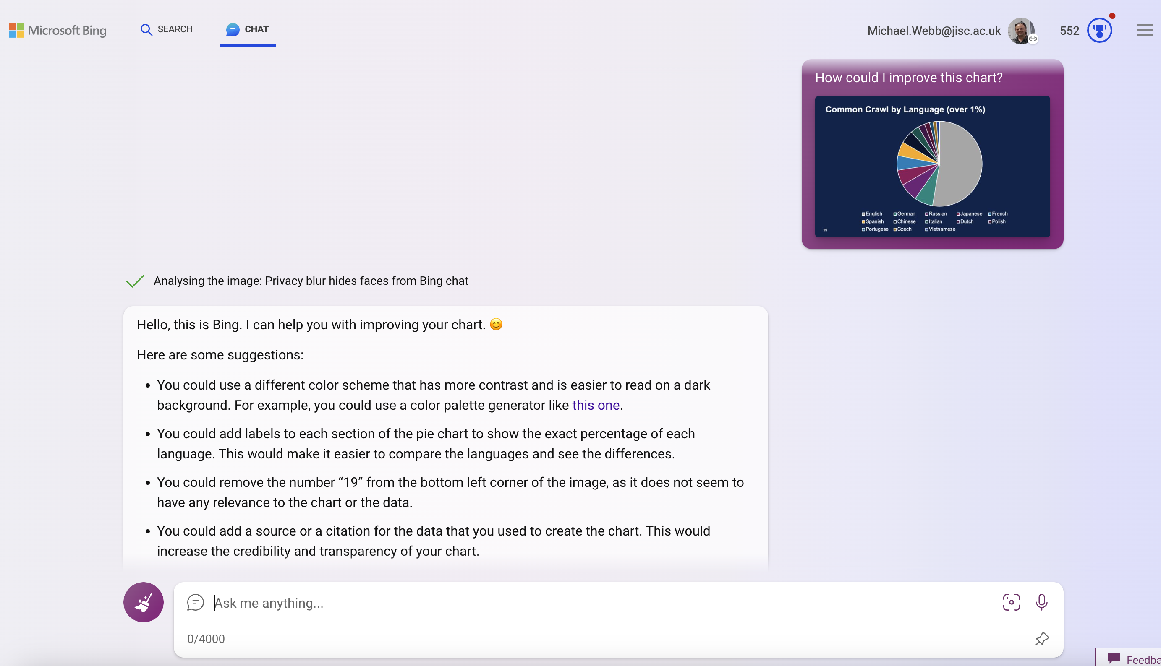
Bing Chat and ChatGPT can read pictures…

Slide 17
ChatGPT and generative AI
What we see across the education sector
Lot of discussion around assessment and policy (avoid, outrun, embrace)
Initial assessment guidance for students produced
Some early (speculative) ideas about how to use it in learning and teaching
Widespread use by students
Broad acknowledgement that work will change too, but limited action at the moment

Slide 18
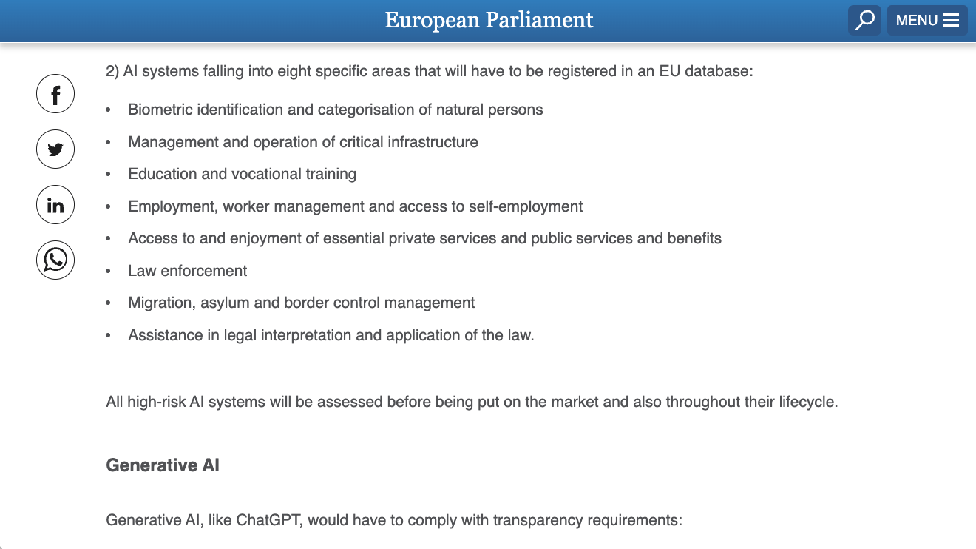
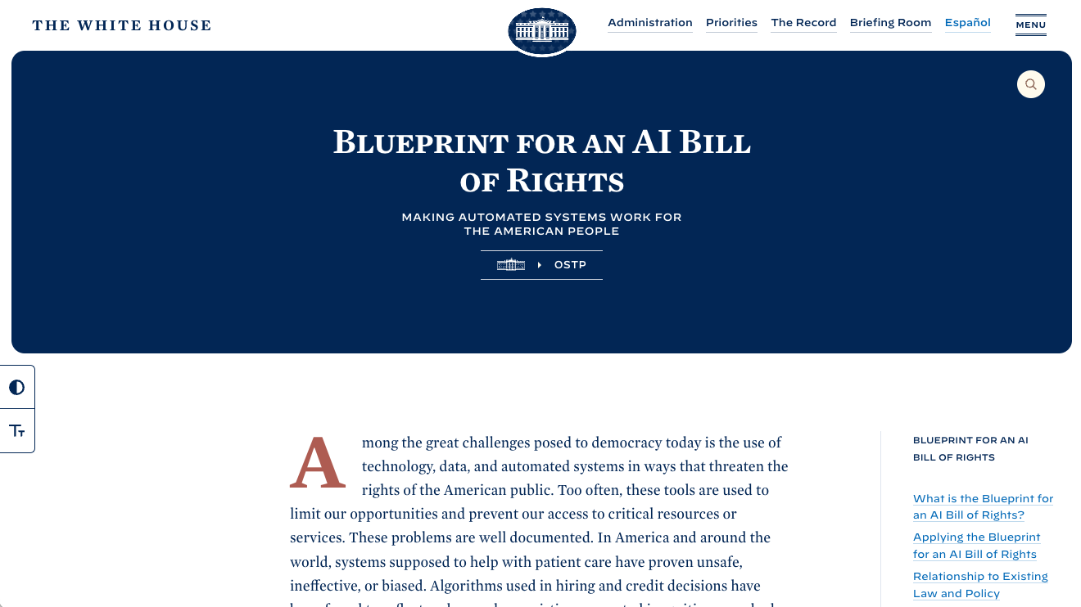
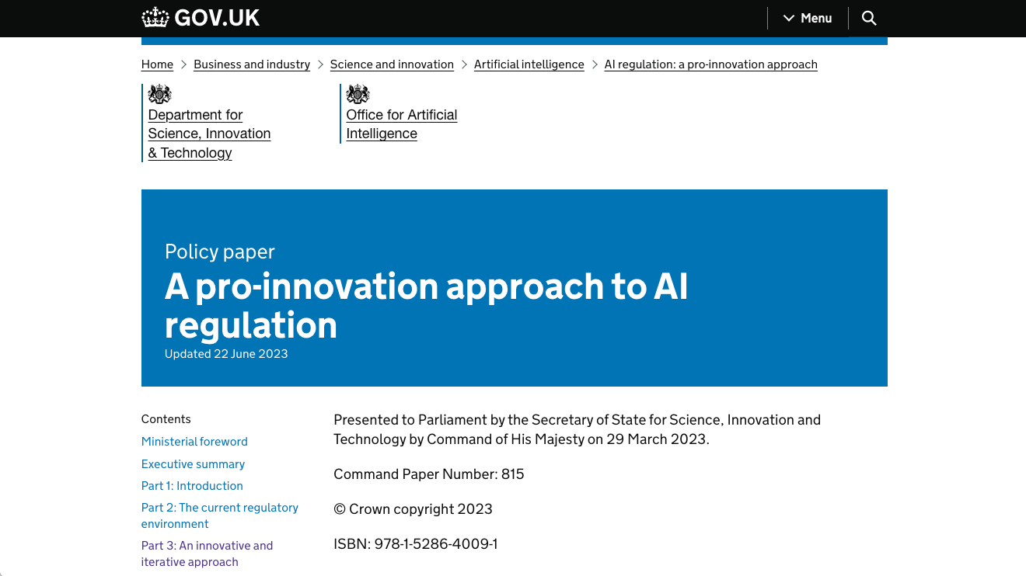
Approaches to regulating AI diverging globally

Slide 19
Challenges: assessment

Slide 20
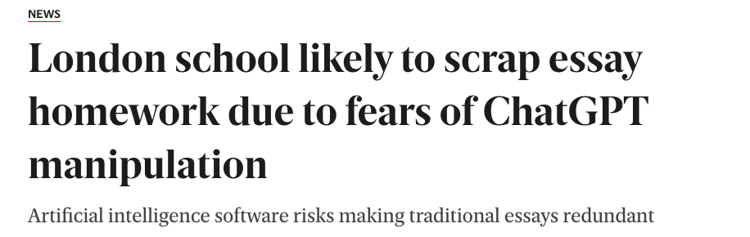
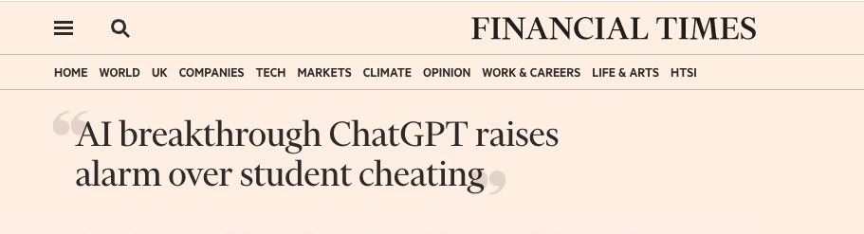
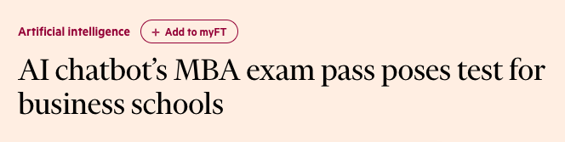
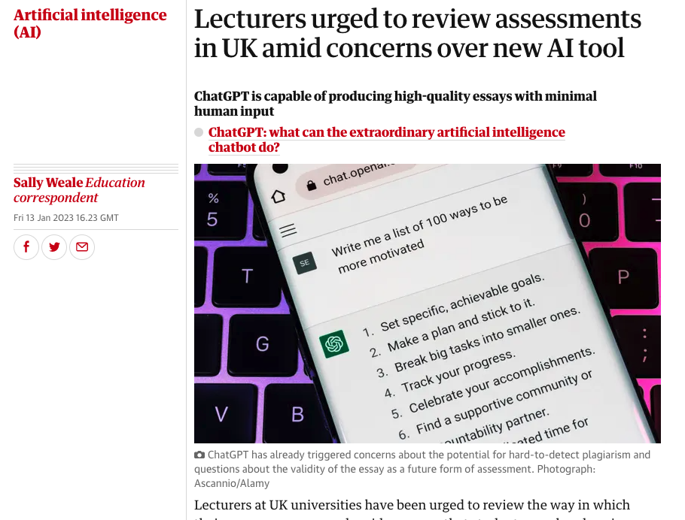
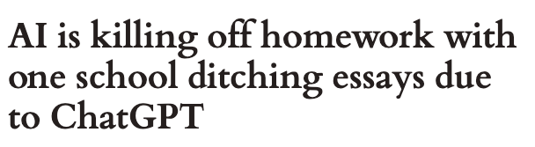
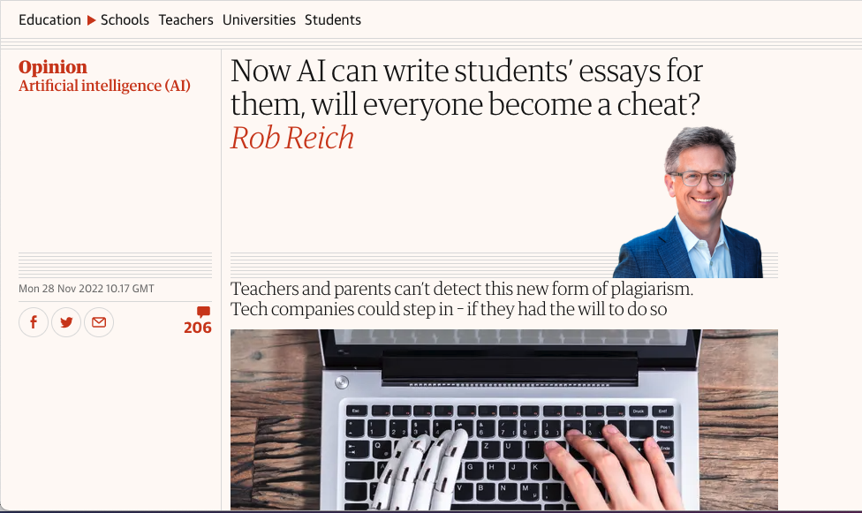
Challenged: assessment examples
20

Slide 21

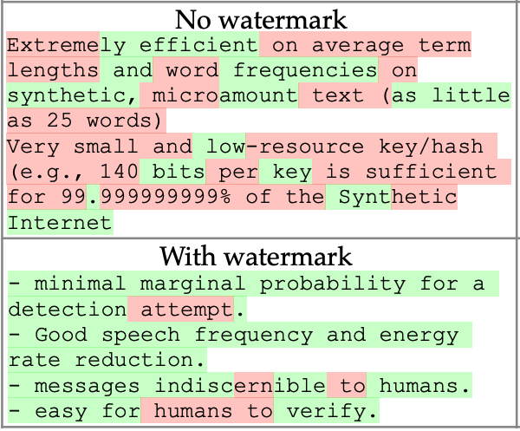
Is it possible to detect AI?
Sort of…
No system today can conclusively prove text is written by AI.
Three main techniques (writing style, classifiers, watermarking)
Each technique can be defeated
Each technique will give false positive
21

Slide 22
Tactics for assessment
Strategy | Approach | Challenges
Avoid | Revert to in-person exams where use of AI isn’t possible | This moves away from authentic assessment and creates many logistical challenges
Outrun | Devise an assessment that AI can’t do | AI is advancing rapidly and given the time between the assessment being set and it being taken, AI might well be able to do the assignment when it is taken
Adapt and Embrace | Embrace the use of AI, discuss appropriate use of AI with students, and actively encourage it’s use to create authentic assessments | Balancing authentic assessment and use of generative AI with academic integrity is a challenge

Slide 23

What do awarding bodies say?
WJEC point to JCQ’s advice

Slide 24
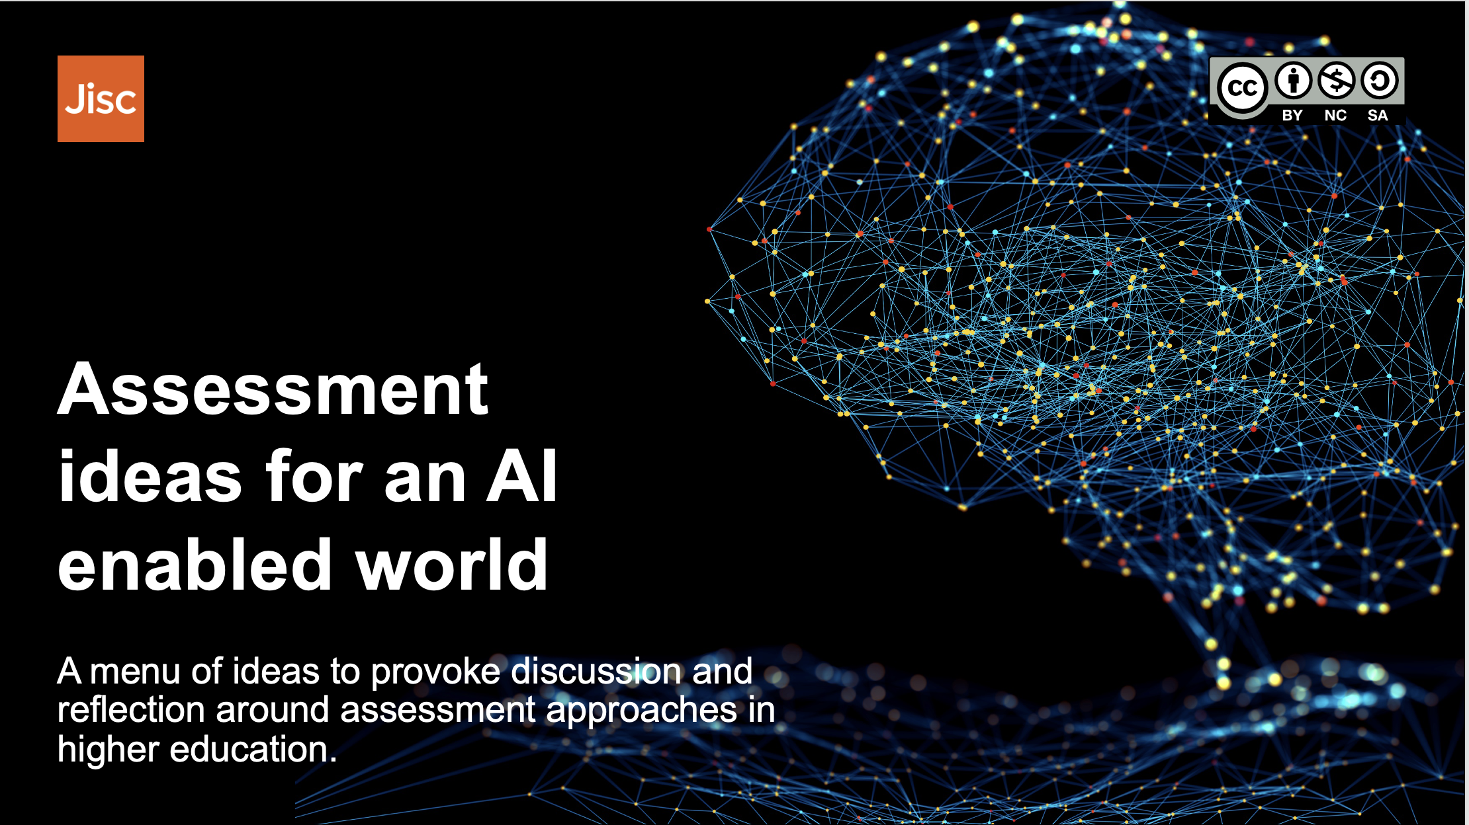
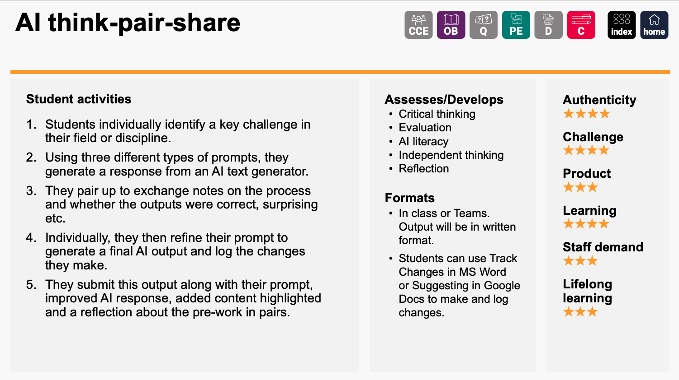
Collaboration example
Led by colleagues from UCL, co-developed with colleagues from Leeds, York, West of England and Portsmouth

Slide 25
Challenges: meeting students needs and expectations

Slide 26
Ways students are using ChatGPT
Research tool
Getting started
Translation
Iterate and discuss to create assignment
Just paste the question in
Exploring concepts
Creating structure
Rewriting sections
Single basic prompt and submit
Creating images
Sophisticated single prompt
Safe proofreading
Getting feedback
More acceptable?
Less acceptable?

Slide 27
Student concerns:
Information literacy: navigating trust and accuracy
Data security: safeguarding privacy and ownership
Detectors: plagiarism concerns and ambiguous guidelines
Regulation: striking a balance
Staff use: transparency and confidence
Equity: access and affordability
Over reliance: balancing AI and intellectual development
Employability/jobs: skills development and impact of automation

Slide 28
Digital inequality
 | Notes | Monthly cost
Grammarly | Including generative AI | £10
Midjourney | Image Creation | £8*
ChatGPT Plus | Latest GPT and plugins | £16*
Writesonic | AI powered writing tool | £13*
Gamma | Presentations | £13
Scite.ai | AI powered research assistant | £16*
Total |  | £77
* Price in dollars so rounds to £ at 30 Jun 2023 rates

Slide 29
Opportunity: saving staff time

Slide 30
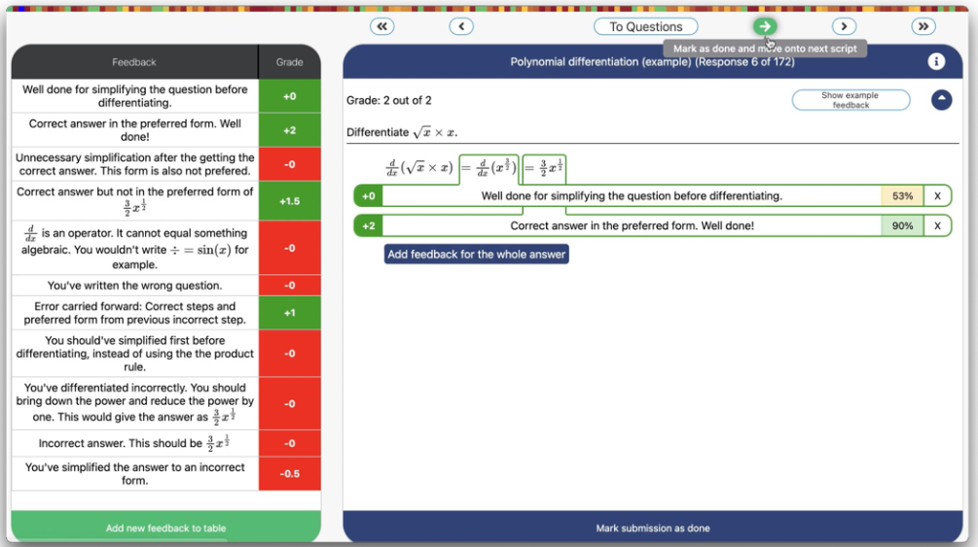
Jisc pilot example: Graide
Accelerating marking of STEM.
Initially created by University of Birmingham students.

Slide 31
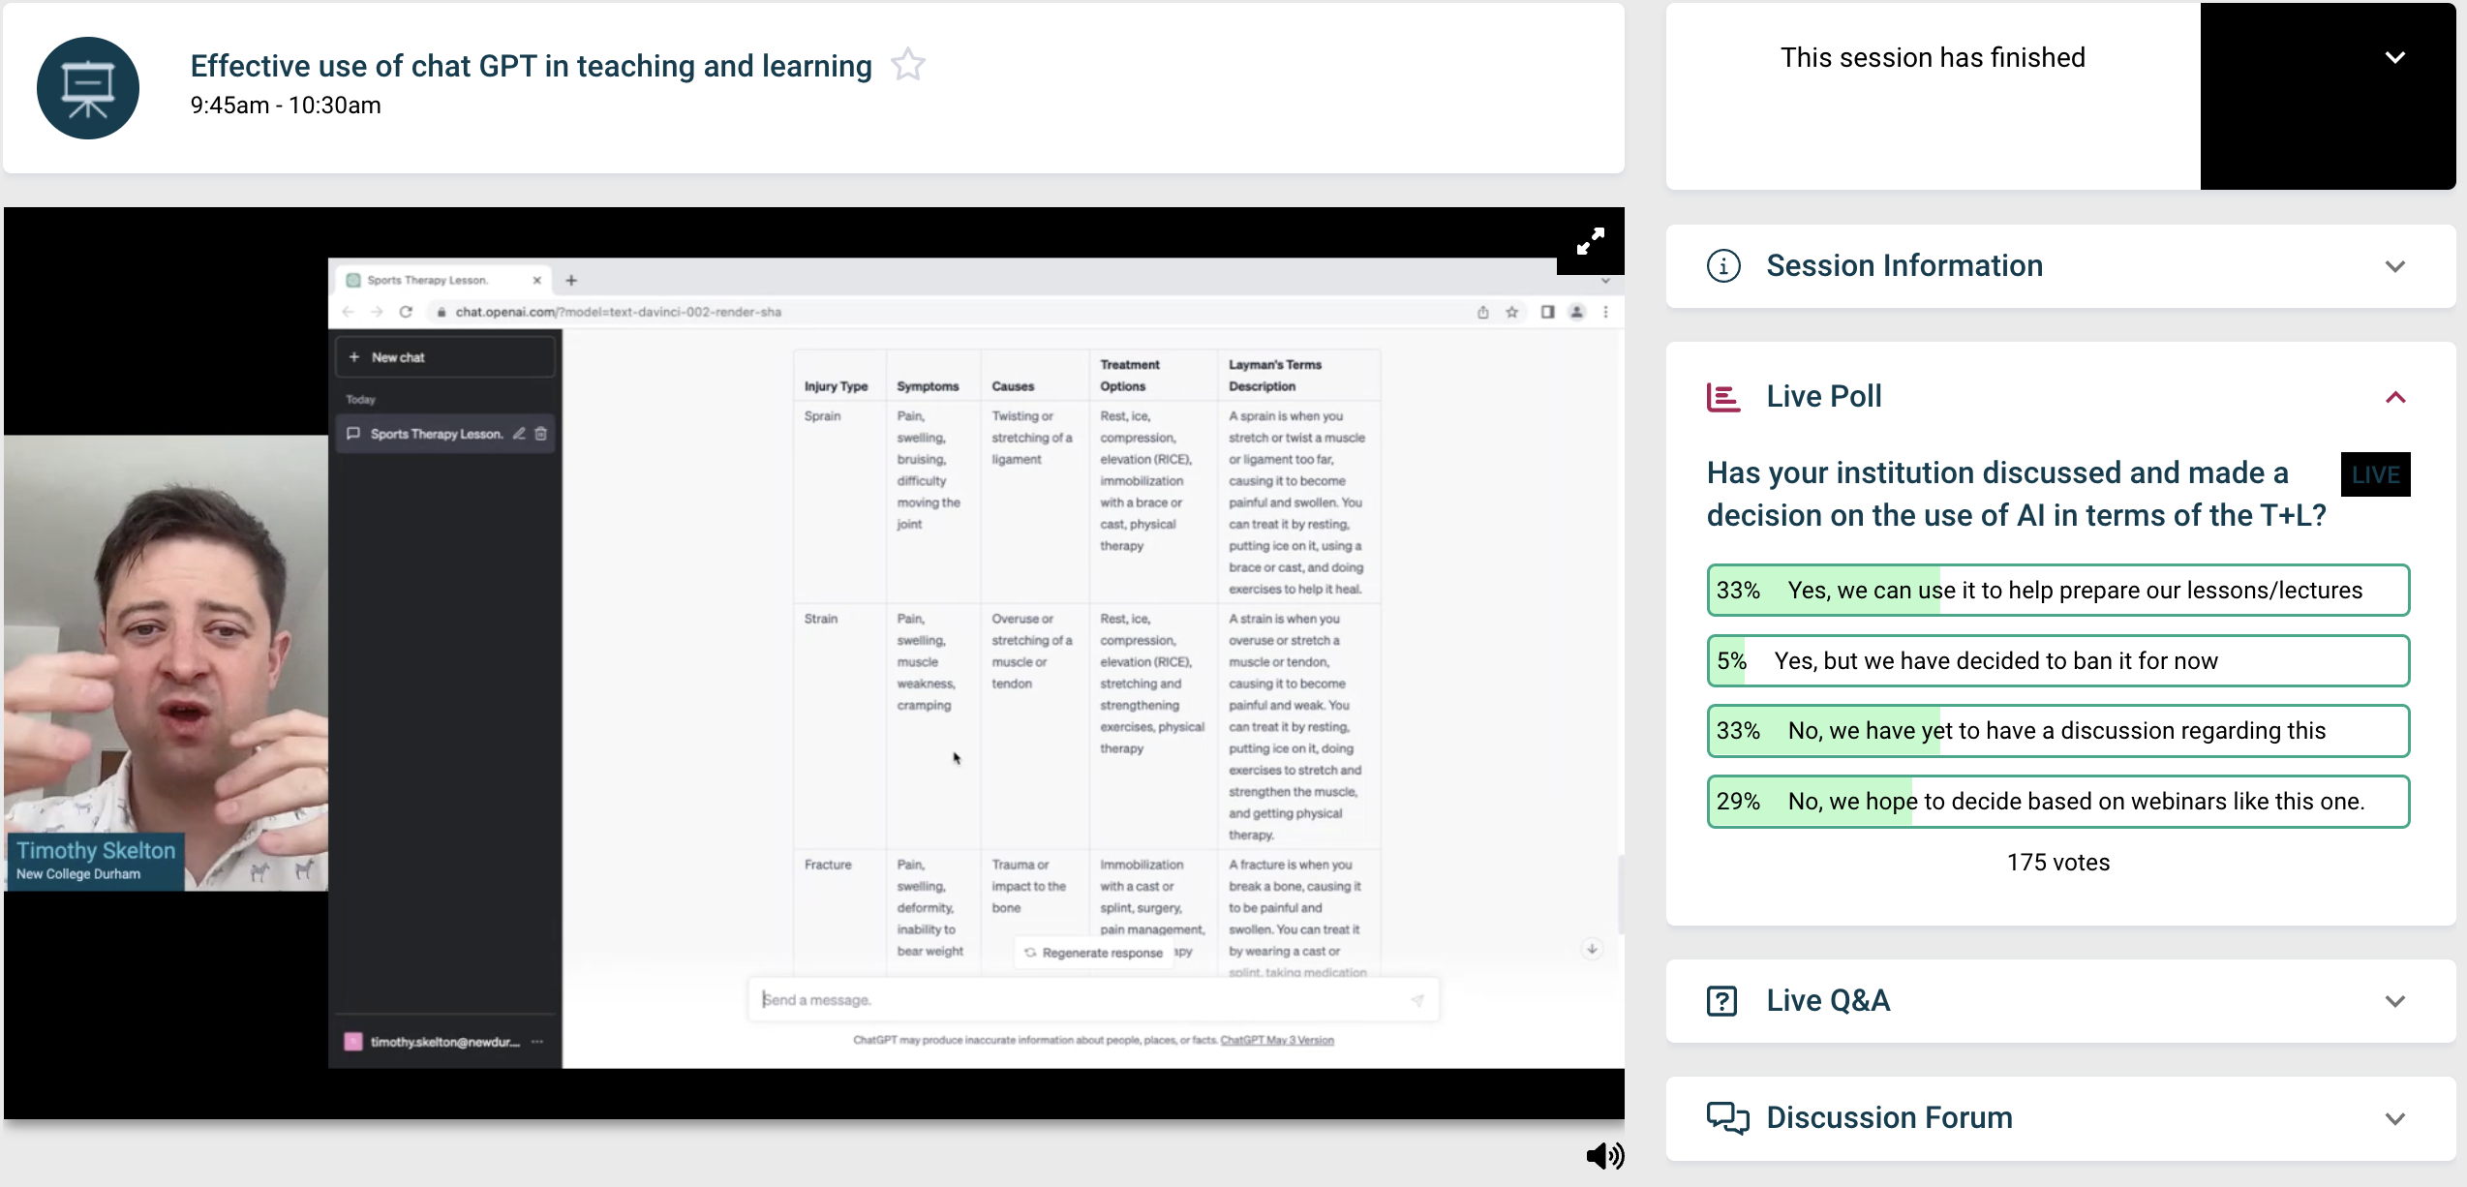
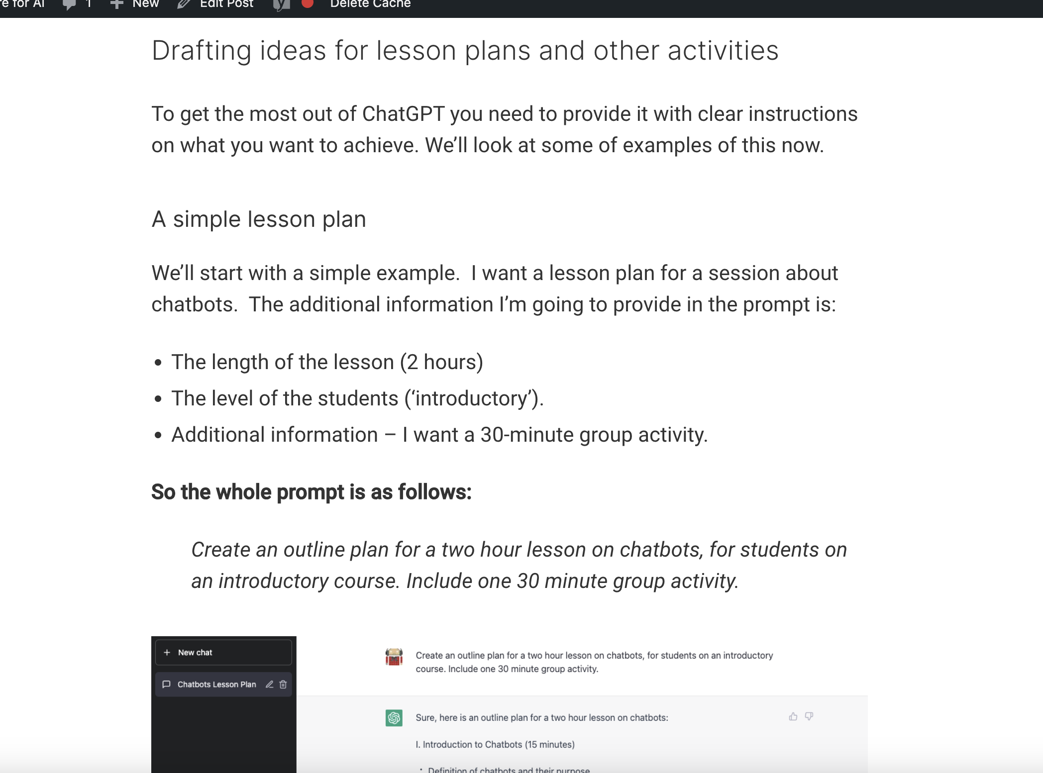
With ChatGPT…

Slide 32
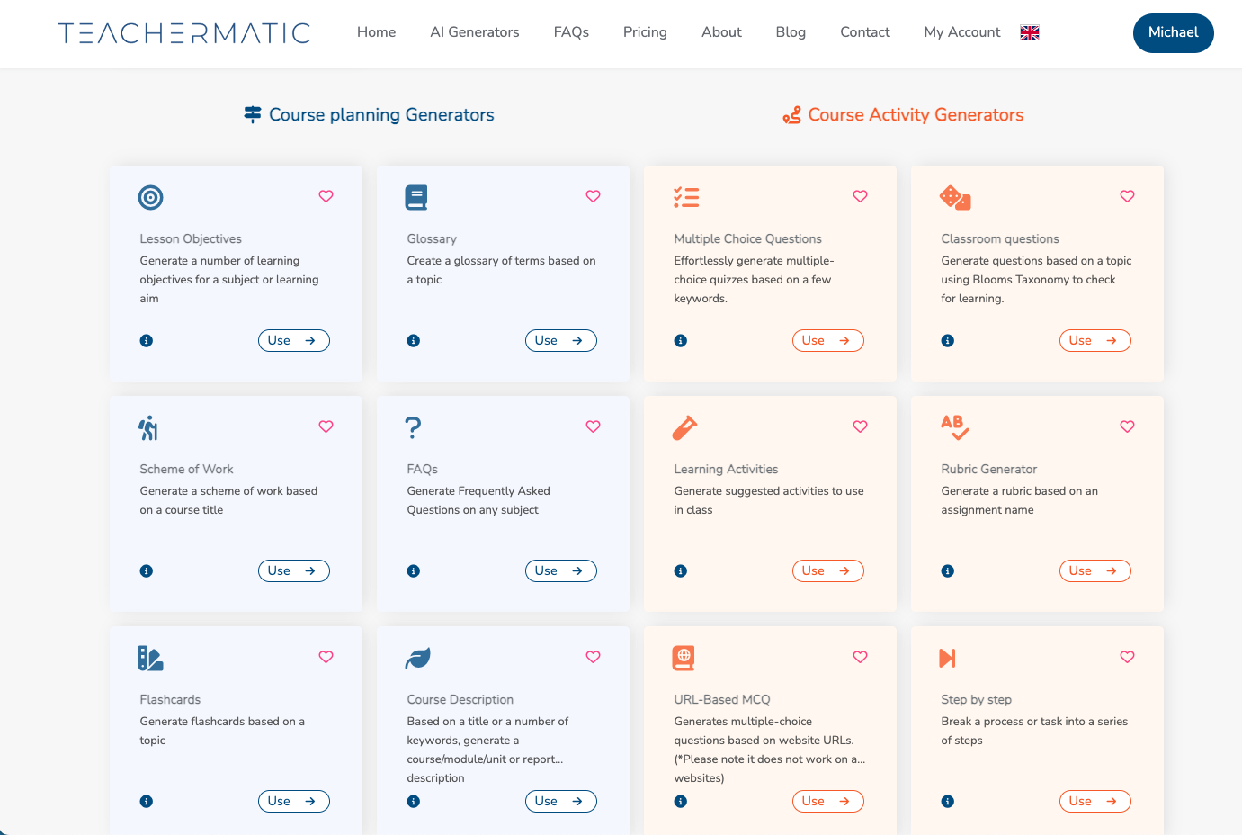
Jisc Pilot example: Teachermatic

Slide 33
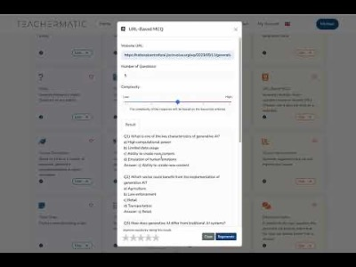
Teachermatic:

Slide 34
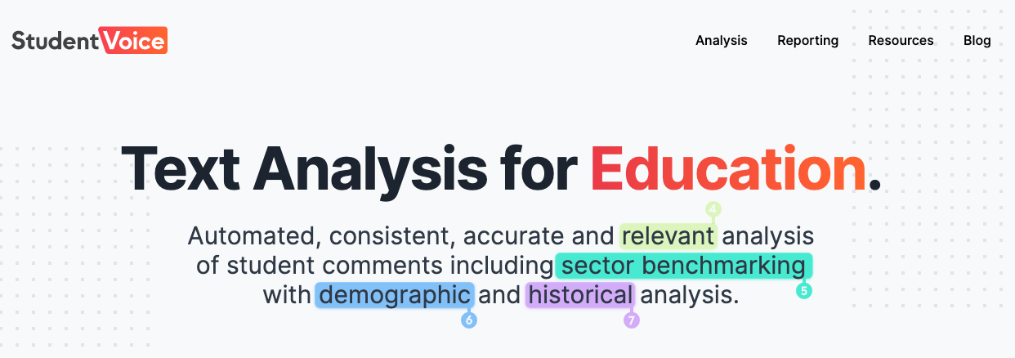
Jisc pilot example
Accelerating analysis of student feedback comments.

Slide 35
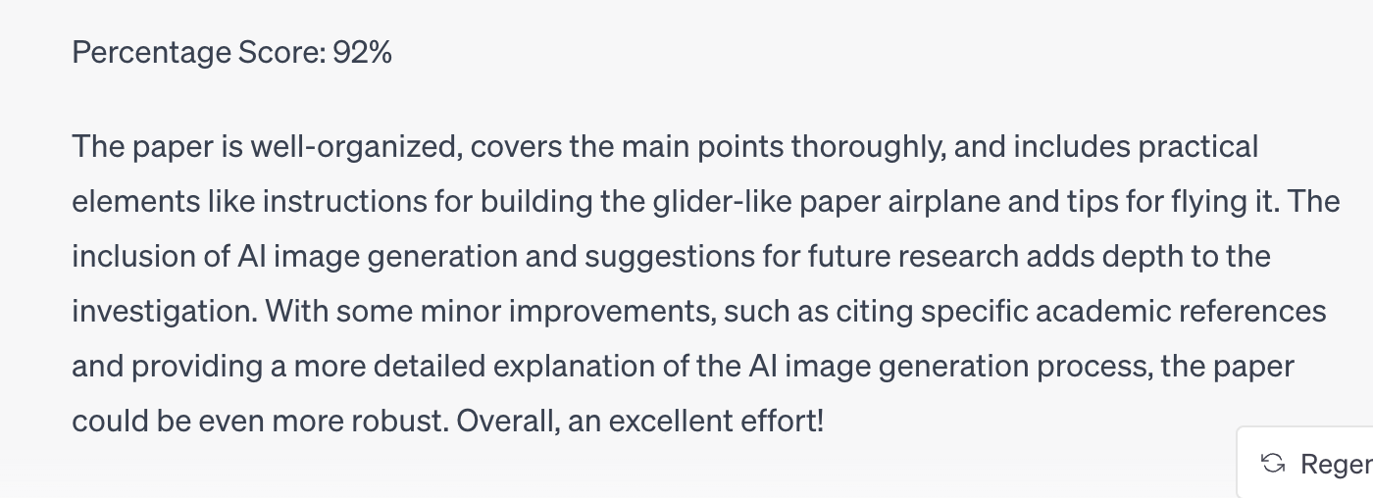
AI assisted marking and feedback
Generative AI is remarkably good at producing plausible marks and feedback for work.
We need to understand how it is best used (if at all) and produce clear guidance.
Without this, we are going to see misuse, either due to misunderstanding, or due to pressures and opportunity.

Slide 36
Opportunity: new teaching and learning opportunities

Slide 37
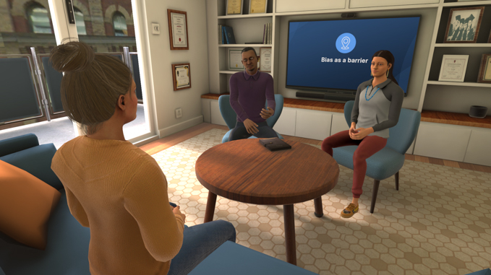
Pilot example: Bodyswaps
VR/AI to help with soft skills.
We’re also see more and more of this in other spaces e.g. medical.

Slide 38
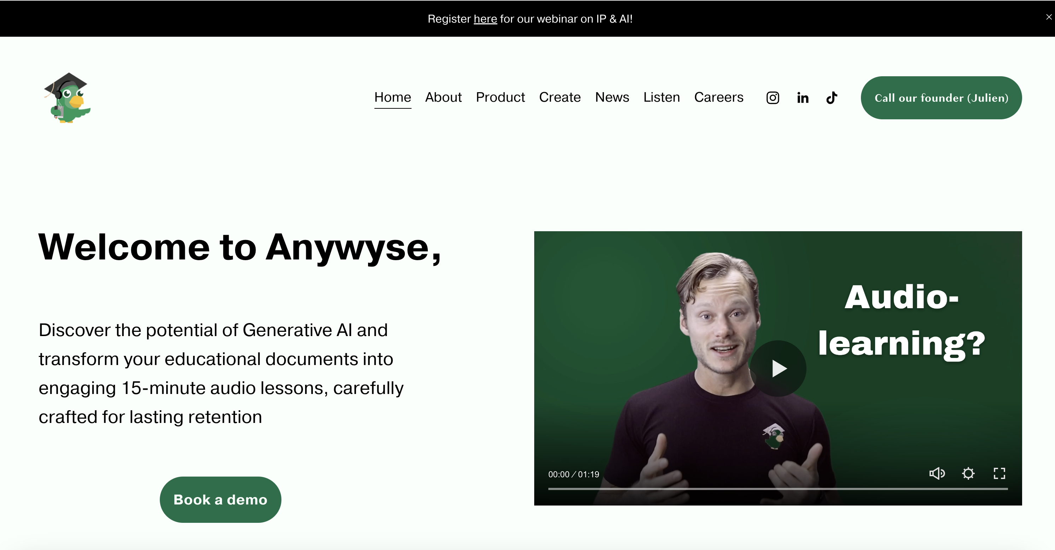
Pilot example: Anywyse
Audio learning resources, created with the assistance of AI.

Slide 39
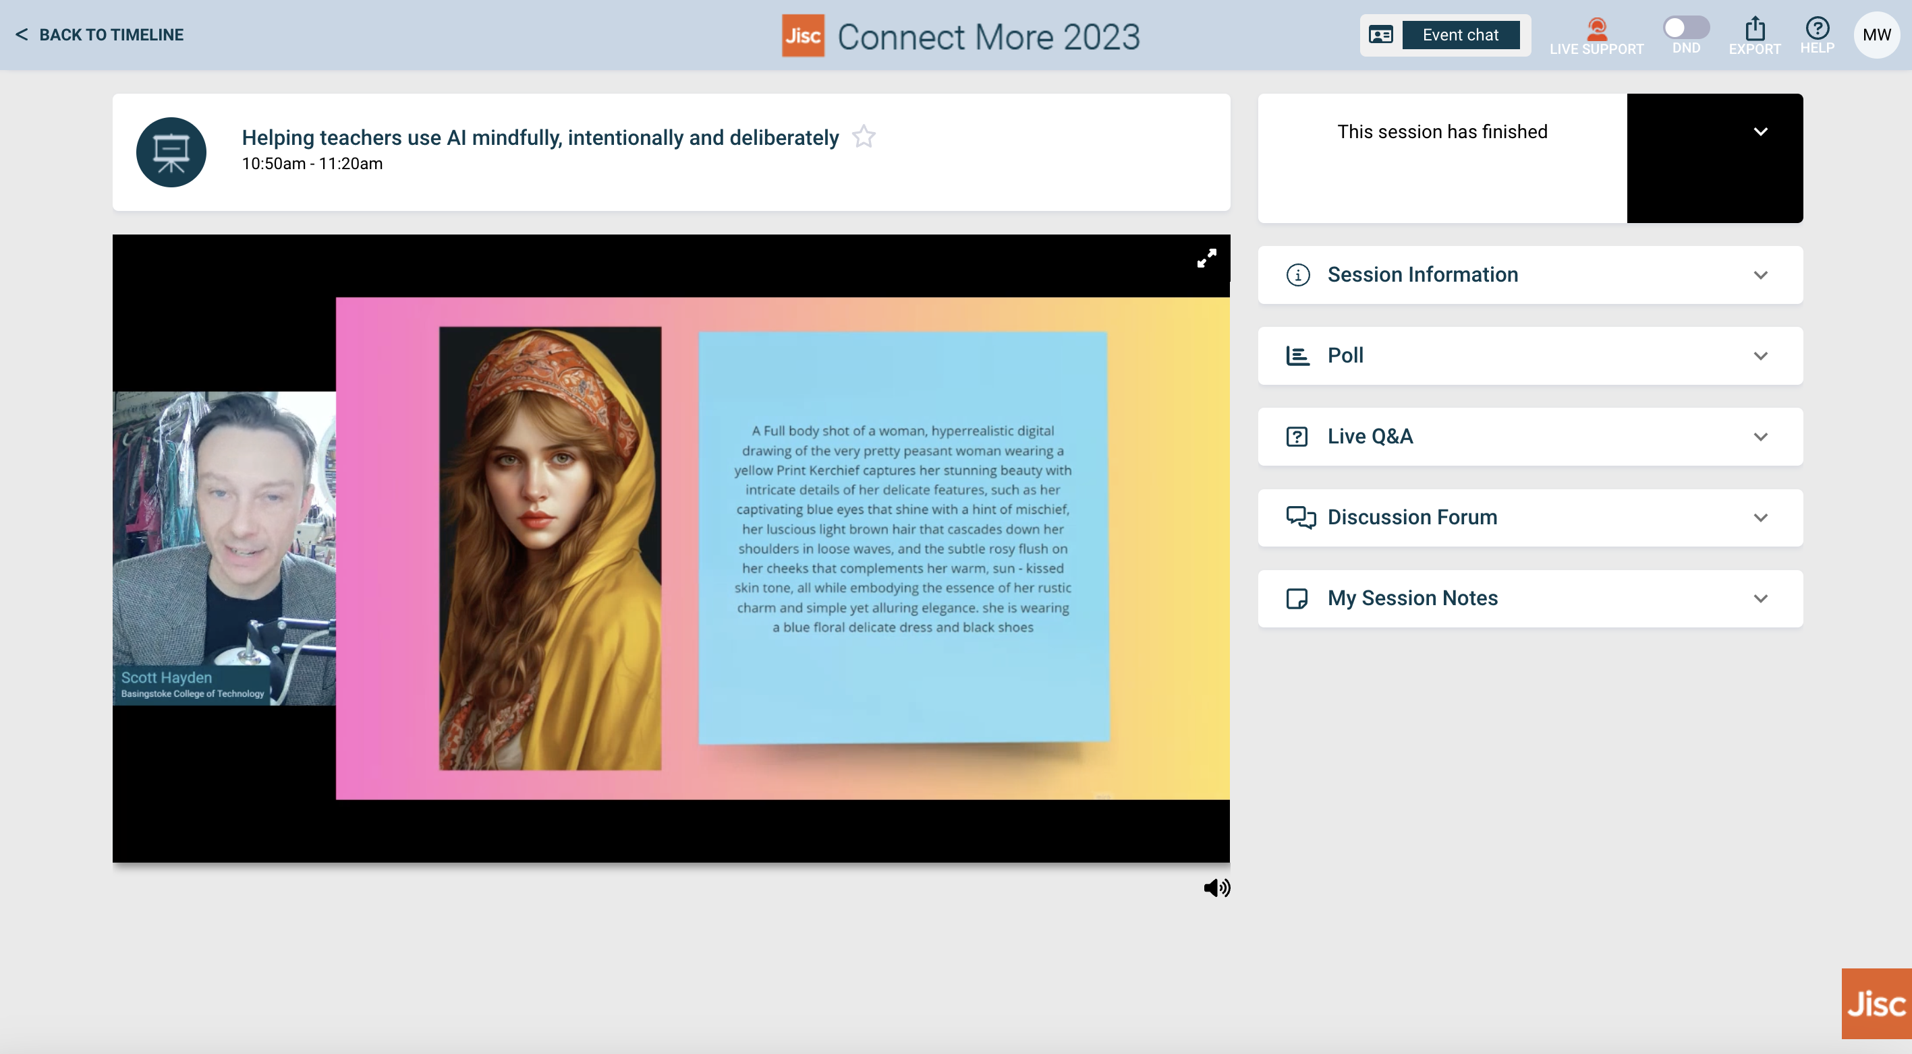
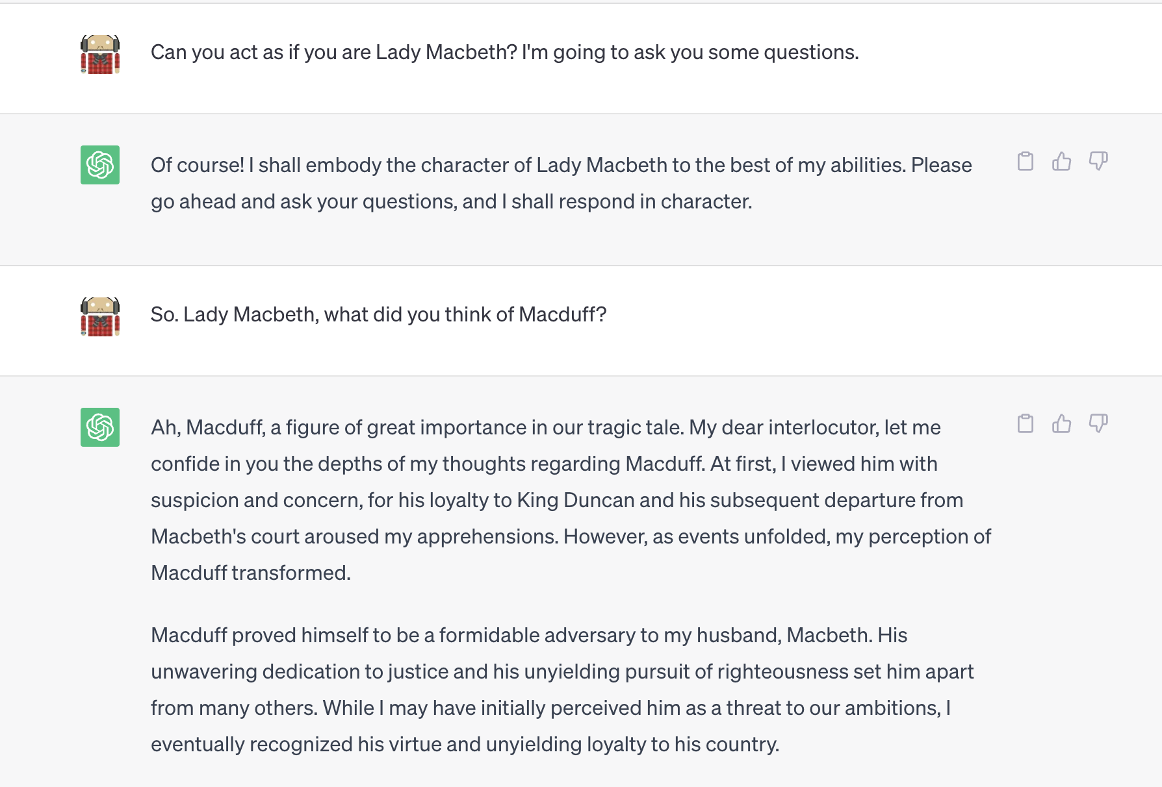
Some colleges are already doing exciting things…

Slide 40
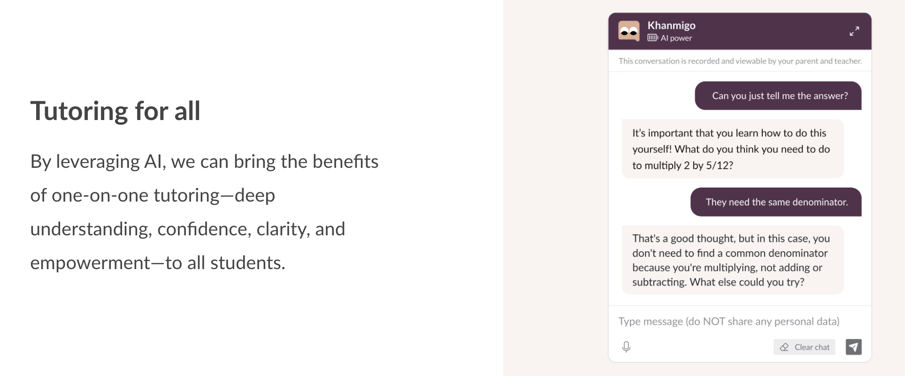
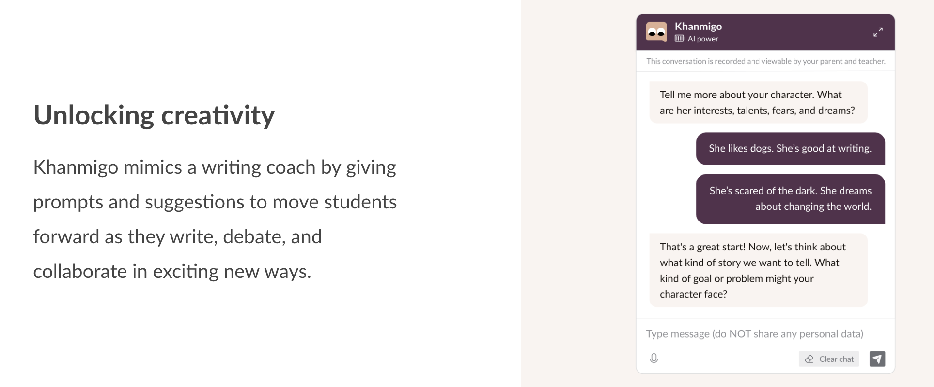
And there are some examples like Khanmigo that point to future opportunities…

Slide 41
Activity
Work in groups to map out your hopes for education and how/where AI can best support them. What support will you need to achieve them?
            Near term
            Mid term
            Long term
Feedback in groups – 10 mins

Slide 42
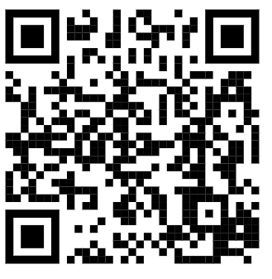

Contact details
Web: https://www.jisc.ac.uk/national-centre-for-ai
Email: ncai@jisc.ac.uk
Stay up to date join our mailing list AIED@jiscmail.ac.uk

